Slide 1
Higher Education

Slide 2
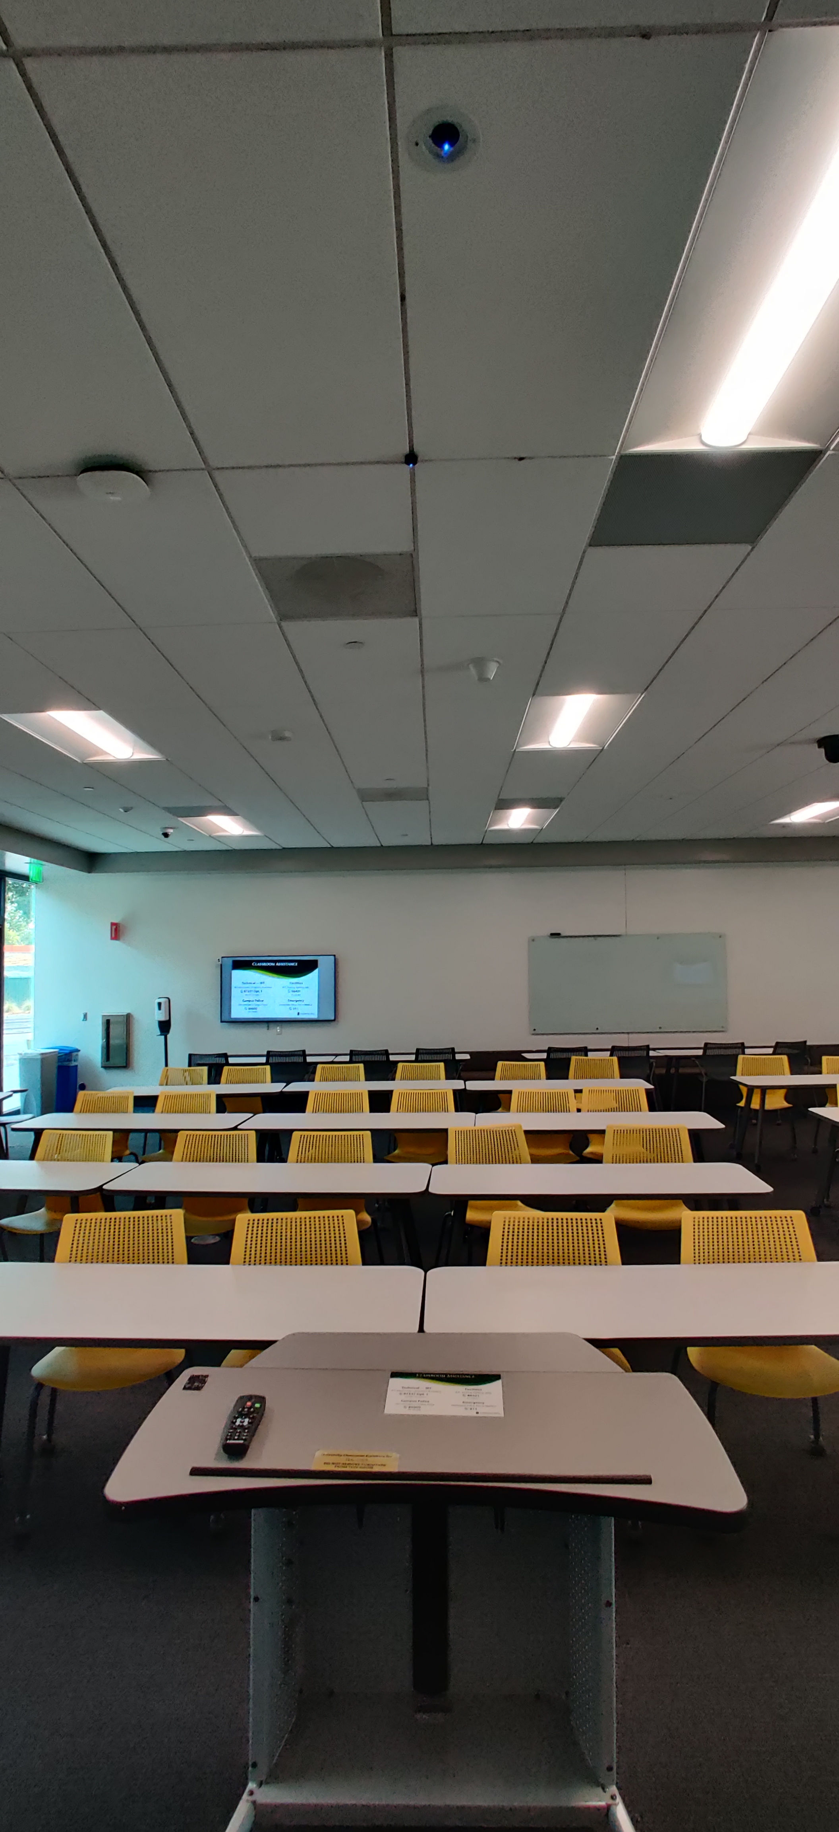
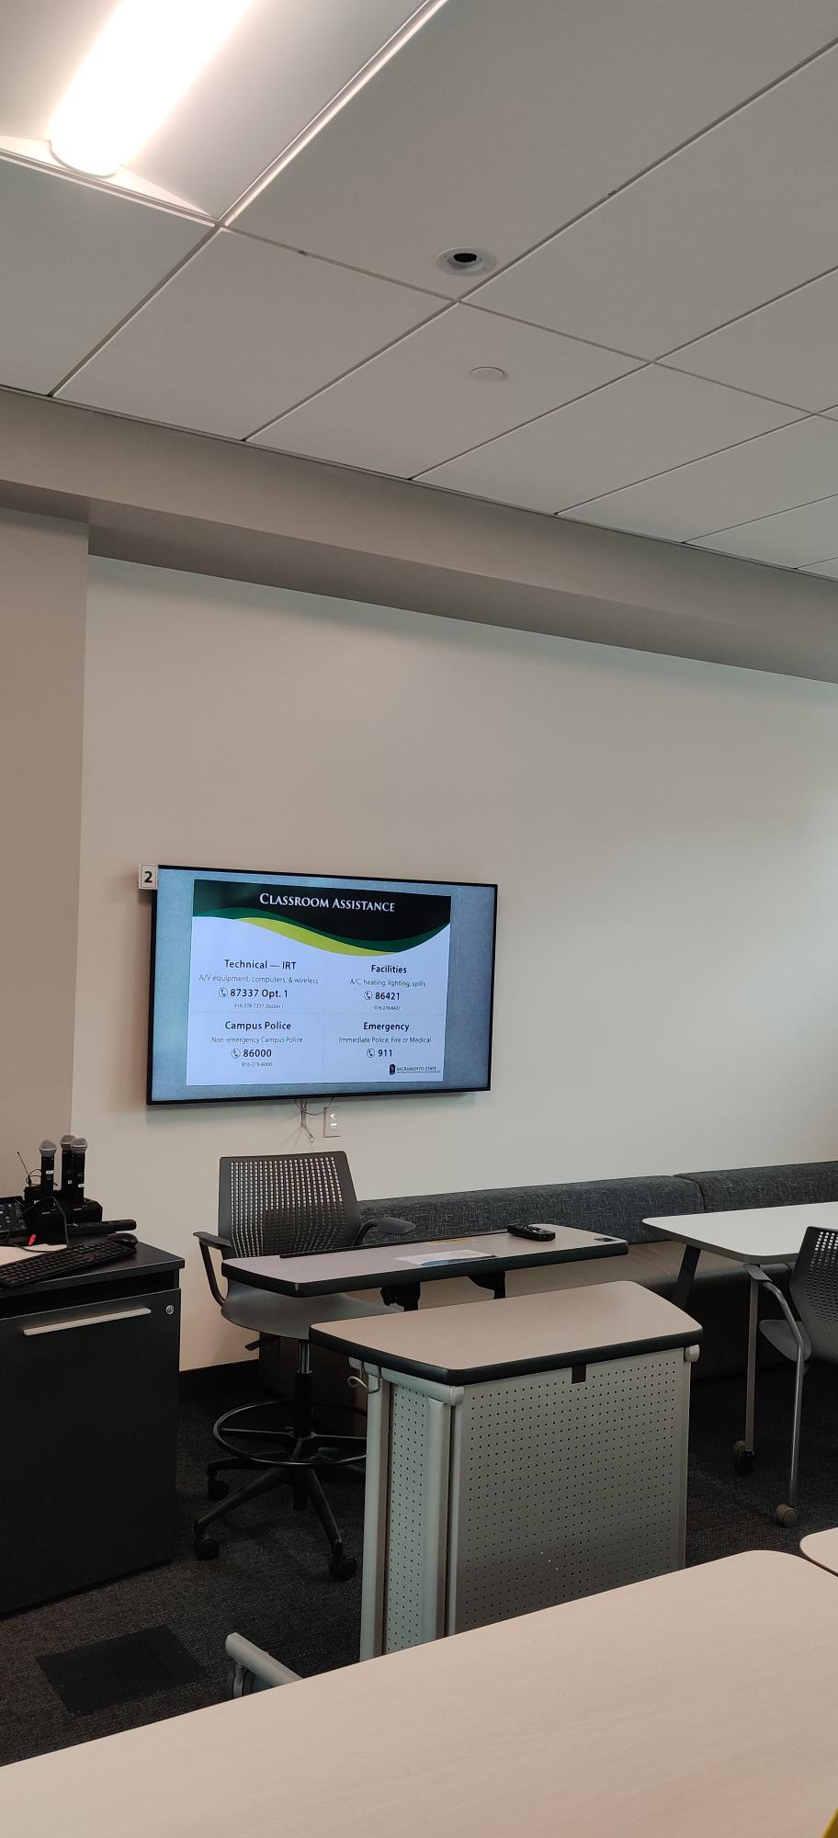
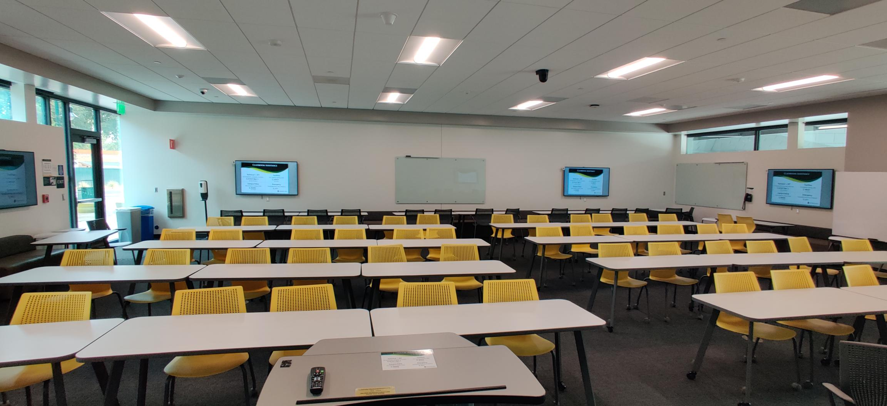
When it comes time to upgrade our classrooms, we look for functional pieces of equipment to provide support for the room's use case and improve the end-user experience. Many rooms had requests from faculty for document cameras but could not implement normal ones that sat on top of the desks due to space and other factors. We reached out to one of our AV contractors and they recommended us to Lumens. At the time, the Lumens CL510 was one of the very few options for ceiling-mounted document cameras doing it well. We purchased a few and installed them in our new science building.
California State University
USA
Success Stories
Higher-Education
Product: CL510, CL-AC01
California State University (CSU) plays a critical role in providing future leaders with the skills and knowledge they’ll need to thrive in the workforce and help drive California’s economy. With more than 132,000 annual graduates, CSU is the state’s greatest producer of bachelor’s degrees and drives California’s economy in agriculture, information technology, business, hospitality, life sciences, healthcare, public administration, education, media, and entertainment.
Installation was fast and easy and tied into our existing AV system without much fuss. Since then (almost 4 years now), no issues have been reported and we have continued to use them for rooms that fit its use case.
“Lumens CL510 paired with the CL-A01 Ceiling Mount Bridge accessory kit were the best option for many of our spaces that required nonobtrusive document cameras. They provide an adequate image quality with great reliability. They have excellent control and response when used with our current AV systems and implemented seamlessly without much installation experience being required. I'm looking forward to getting my hands on the newest model.”
Danny Ngouyaphanh
Information Technology Consultant, CSU Sacramento

Slide 3
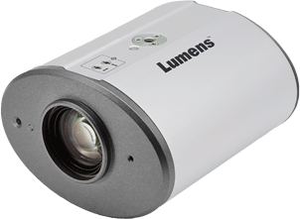
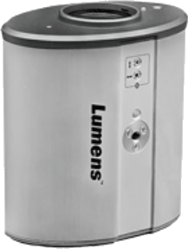
California State University
USA
Lumens CL510
Ceiling Document Camera
Full HD 1080p high-definition 30fps camera
30x optical zoom
DVI, USB, Ethernet and VGA
Supports RTSP streaming and PoE
Multiple local and remote control options
5 Year Warranty
Success Stories
Higher-Education
Product: CL510, CL-AC01
CL510
Lumens CL-AC01
PTZ Camera
Ceiling Mount Bridge for CL510
HDMI Matrix
Notebook
PC
LCD Displays *8
Lectern

Slide 4
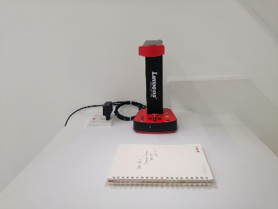
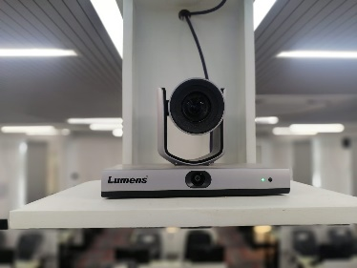
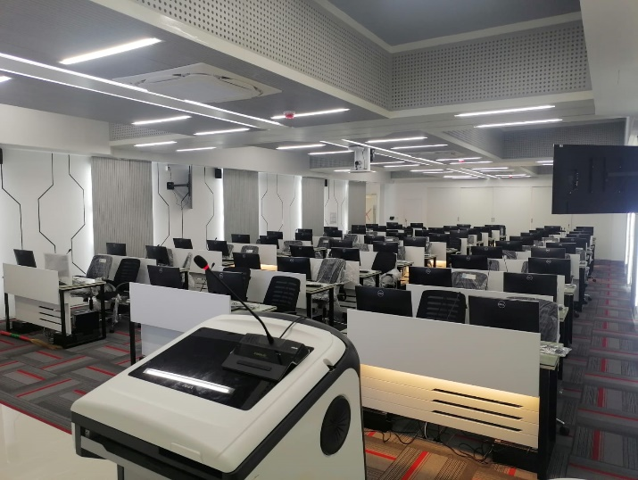
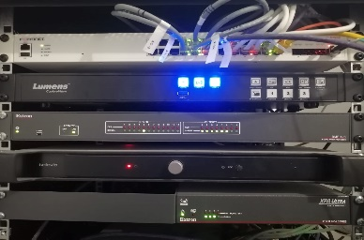
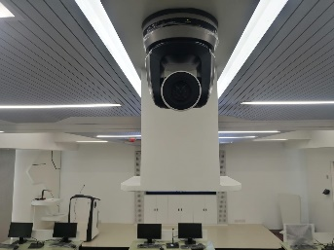
Military Institute of Science and Technology
Bangladesh
Success Stories
Higher-Education
Product: VC-TR1, VC-A51P, DC-F80, LC200
Military Institute of Science and Technology (MIST) is a PhD granting public research university in Bangladesh specialized in Engineering. MIST is well equipped with advanced engineering laboratories and research facilities for the fulfillment of country's technological needs.
The end user wanted to transform the conventional set up in Military Institute of Science & Technology (MIST) Bangladesh, to a modernized set up helping them to communicate across classrooms. Online conferences, recorded videos, live streaming and audio calls to be simpler with no limit.
“On the basis of the full fledged solution with proper demo support, Lumens as a brand was recommended internally which no other brand could do so.”
SI feedback-BRIGHT-i

Slide 5
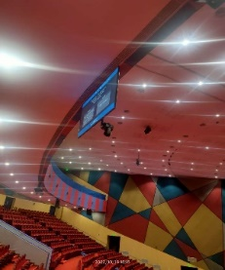
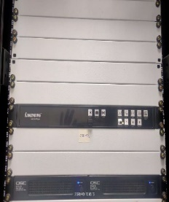
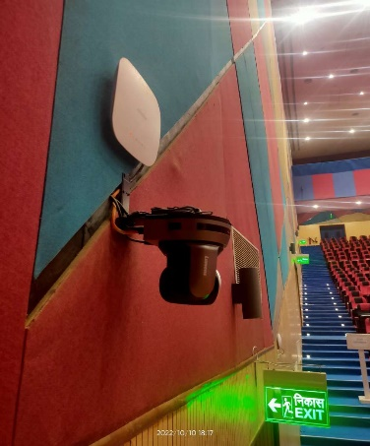
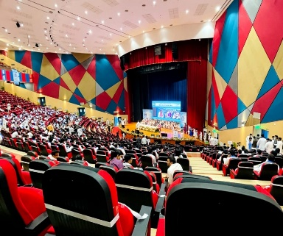
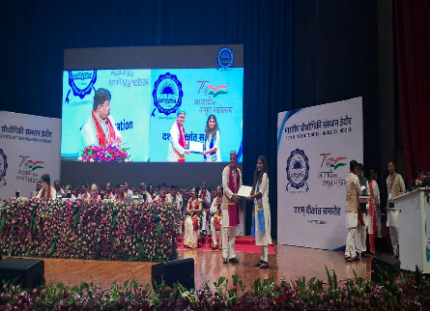
IIT Indore, India
Since our cameras supports PoE and can be easily connected with LC200 on IP, so proposed 8x VCA61P for the complete coverage. The best thing was that the cabling was not a challenge as all the Lumens products were connected on Cat6 so cabling and integration was all the more easier for the system integrator. Secondly, all Lumens cameras could be further connected with LC200 which was needed for recording, streaming and switching purpose.
Success Stories
Higher Education
Product: VC-A61P、LC200
This Auditorium is one of the biggest auditoriums in IITs with a seating capacity of 2600. This auditorium is being used for multiple events on regular basis. IIT Indore wanted to capture the complete auditorium for events and do live streaming and also connect via VC sometimes for guest lecturers. Since the auditorium was huge, so cabling till the AV Control Room was a challenge.
IIT Indore’s new campus has been designed on AVoIP Platform. Since Lumens Cameras and Media Processor supports IP , hence the integration of the Lumens set up with other AVoIP products made the solution easy to integrate and manageable.
Mr. Yogender-IT Head

Slide 6
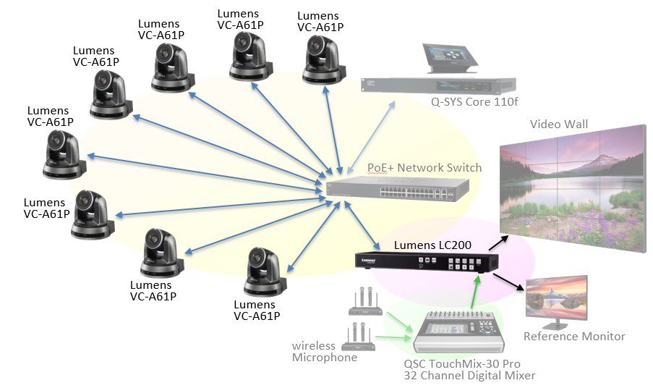
IIT Indore, India
Success Stories
Higher Education
Product: VC-A61P、LC200

Slide 7
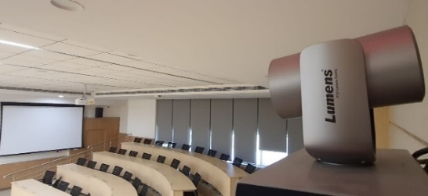
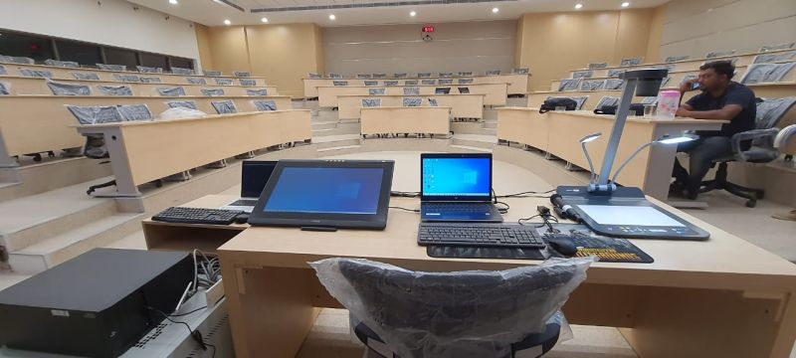
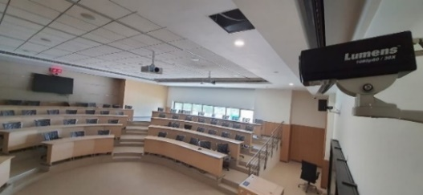
IIM Nagpur
India
Success Stories
Higher Education
Product: VC-TR1, VC-A61P, VC-BC601P, PS752
The Indian Institute of Management Nagpur (IIMN) is a business school located in Maharashtra. The campus is fully connected with students benefitting from state-of-the-art classrooms and access to online academic resources.
As part of its drive to deliver world-class education, IIM Nagpur leverages technology such as Impartus Software. This e-learning platform is designed for lecture capture and streaming, enabling colleges and universities to offer students online learning and interactive blended classrooms.
A key part of the solution is Impartus Software which is designed to be easy to integrate and use.
The Institute installed Lumens VC-TR1 PTZ cameras. The IP, USB, SDI, and HDMI video outputs enables high-quality video streaming and interactive video communications.
“Lumens Products were finalized on demonstrating the solution and showcasing the ease of installation and its use. It was chosen due to its outstanding feature of Recording and Streaming Audio/Video. IP camera controller is also quite handy to control the camera.”
Mr. Prashant Sarafdar
Head - IT

Slide 8
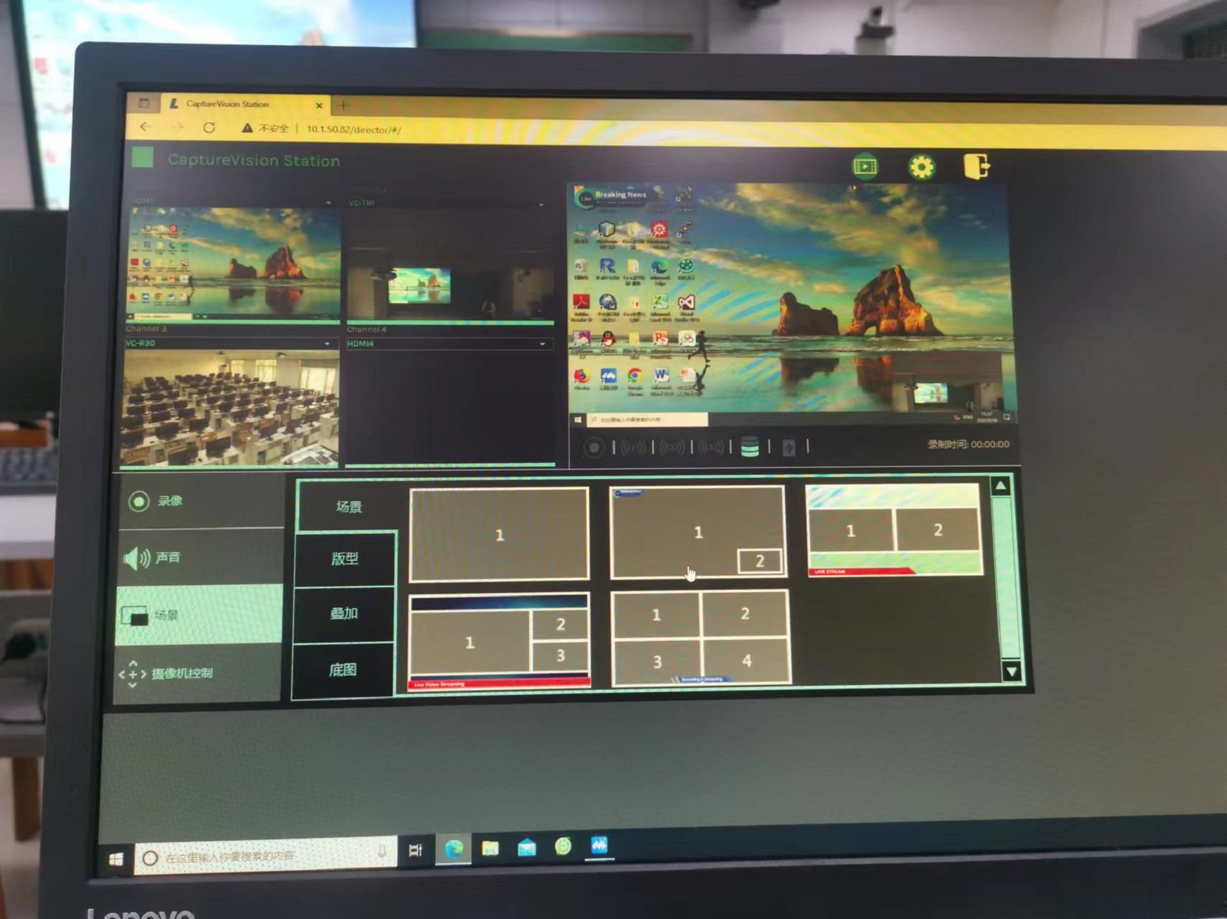
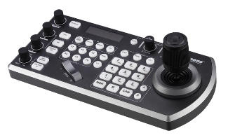
Nankai University
China
Success Stories
Higher Education
Product: VC-TR1, VC-R30, LC200, VS-KB30, LC-RC01
The camera should track teacher automatically while making a lecture (including the walking into students’ area).
A panoramic image for whole classroom is required.
The video and the sound need to be live-streaming and record as well.
Distance conference function is required, so the teacher can do interaction with students from distance.
All courses need to be recorded and uploaded to the online platform, so students can review the course content at anytime, anywhere.
The school will remodel a 7m*10m classroom to a hybrid classroom for online and offline use.

Slide 9
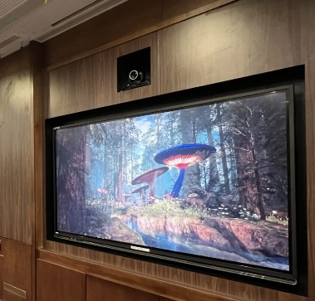
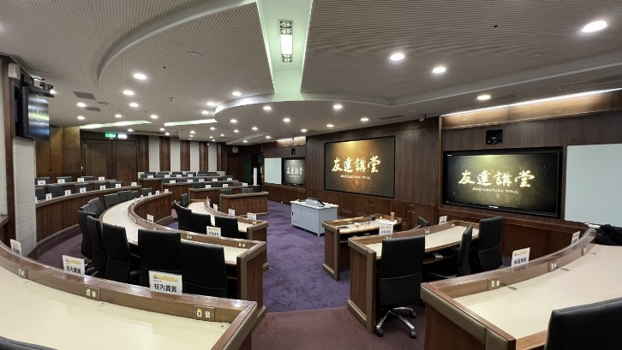
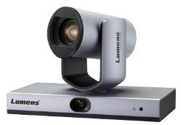
National Tsing Hua University
Taiwan
Success Stories
Higher Education
Product: VC-TR1、VC-B30U、LC200
The AUO Smarter Classroom system includes a 135-inch large LED screen with 86-inch touch monitors on each side. Professors can write directly on the monitor and connect to the large screen. In addition, there are 3 auto-tracking cameras in the classroom. Remotely located students can see and engage with classmates in the room via the other two cameras, and interact in real-time.
National Tsing Hua University is consistently ranked among the top three best universities in Taiwan in world university rankings. It is also a leading university that actively implements the best and newest technologies to help students improve their learning efficiency. This time they used Lumens' LC200 Media Processor, VC-B30U Full HD USB PTZ Camera, and VC-TR1 Full HD Auto-Tracking Camera to build up an advanced Hybrid Classroom. Lumens' classroom solution successfully integrates recording and live streaming to provide students and teachers access to information at any time, anywhere.
"The integrated recording and livestreaming system delivers true interactive learning in smart classrooms. The demand for distance education and hybrid teaching is expected to rise significantly in coming years. Lumens PTZ cameras and AV processors are designed to integrate with smart technology. They are easy to use and consistently deliver excellent results.“
Commented Rick, JECTOR Digital Marketing Specialist

Slide 10
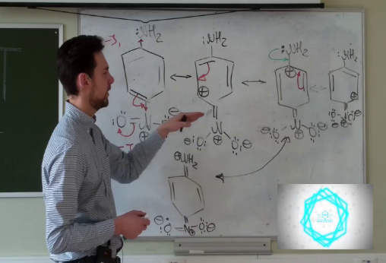
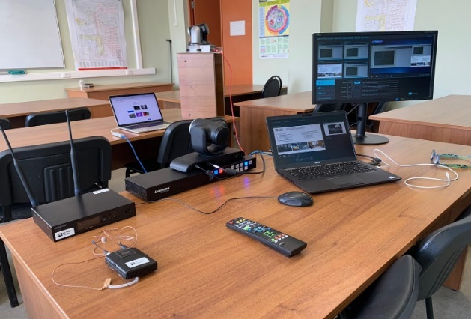
Mendeleev University of Chemical Technology
Russia
Success Stories
Higher-Education
Product: LC200, VC-A50P, VC-B30U
Due to COVID-19 outbreak, D. Mendeleev University of Chemical Technology of Russia start to offer distance learning. The University has branches in other country and regions.
LC200 is used for lecture recording and streaming.
VC-A50P and VC-B30U are connected to LC200 for providing teaching views; Shure QLX wireless microphone system is connected to LC200 for getting voice of the professor.
A laptop is connected to LC200 for showing teaching material.
“Thanks to the work on this equipment in just a few days we managed to fully restore the holding of lectures and seminars, as well as to prepare the first virtual open day of our faculty with an interactive broadcast on the YouTube channel, which has already been viewed by more than 1000 applicants. In addition, we did not have to cancel lectures within the framework of the All-Russian educational project "University Saturdays," as we also managed to put them online. Thank you to our colleagues at High Tech Media and Lumens, and encourage educational organizations to take advantage of our experience”
PhD Roman Yakushin
Dean of the Faculty of Chemical and Pharmaceutical Technologies and Biomedical Drugs in D.Mendeleev University of Chemical Technology

Slide 11
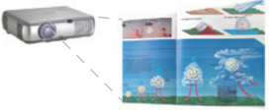
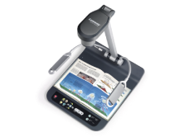
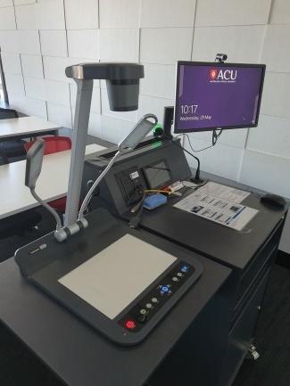
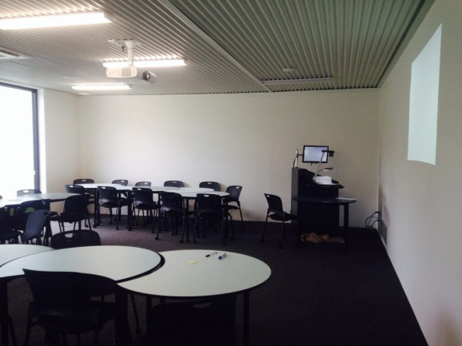
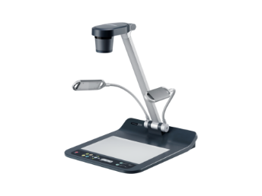
Australian Catholic University
Australia
Speaker
Audio
Projector
Cat 5e
LAN
Amp
Success Stories
Higher-Education
Cat 5e
Audio
HDMI
Product: PS752
Crestron Touch Panel
Crestron DMPS
RS232
HDMI
HDMI
Smart classrooms comprise of a Crestron DMPS, a touch panel, a PC, and a Lumens document camera PS752.Lecturers can show physical document to the class and control the document camera via the Crestron unit.
Classes are often done via video conference to other sites and PS752 make it possible to provide physical document image which a tradition whiteboard would be impossible.
Podium PC
Laptop
HDMI pass-through
Lumens Document Camera
PS752
“The document camera provides our lectures a fantastic opportunity to show physical documents to the class and is often used as a whiteboard function. Overall, we have always found that the Lumens document cameras are easy to use, reliable, of sturdy construction and produce very professional results”

Slide 12
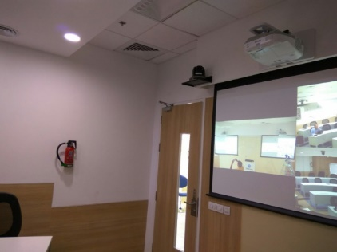
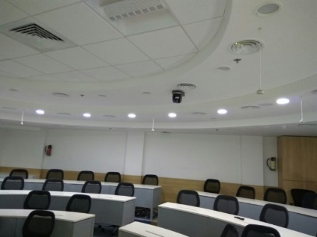
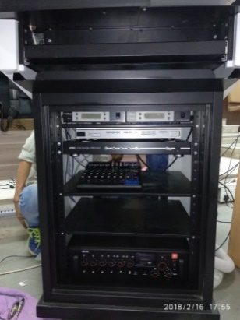
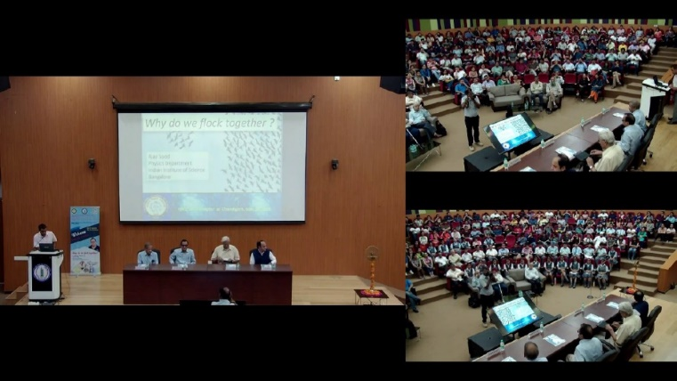
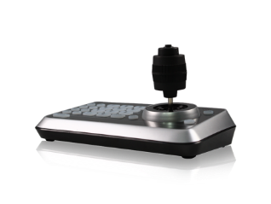
India Institute of Technology
India
Success Stories
Higher-Education
Product: VC-A50P, VC-LC102, VS-K20
3 VC-A50P are installed in the 200 seats lecture hall; one camera captures the presenter, and the other two capture students.
All important lectures are recorded via VC-LC102 and store in the IIT central server.
VC-LC102 is also used to live streaming guest lectures to other IIT campuses.
“Customer Feedback is excellent because of ease of use especially for the IT Team who manages the complete set up in the classrooms as our LC can be controlled through GUI which is a very useful feature as per the technical team”
Hi Tech Media (Installer)

Slide 13
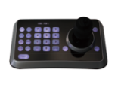
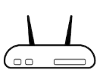
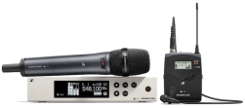
India Institute of Technology
India
Success Stories
Higher-Education
Product: VC-A50P, VC-LC102, VS-K20
RS232
RS232
Lumens PTZ Camera
VC-A50P
RS232
Lumens
Camera Controller
VS-K20
HDMI
HDMI
Cat 5e
Cat 5e
Cat 5e
Video Switcher
Display
HDMI
Lumens
Lecture Capture System
VC-LC102
Cat 5e
Streaming
Content laptop
Network Device
RTP/RTMP
Audio
FTP
Central server
Microphone System
Audio
Audio
Audio
Audio Mixer
Audio amplifier
Loud Speaker

Slide 14
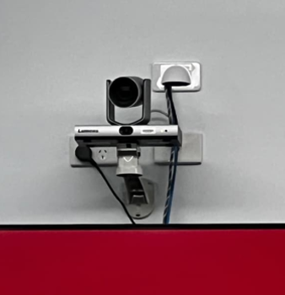
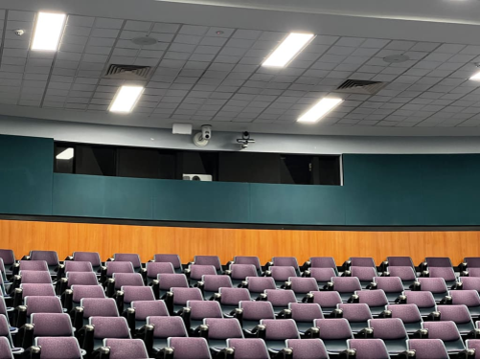
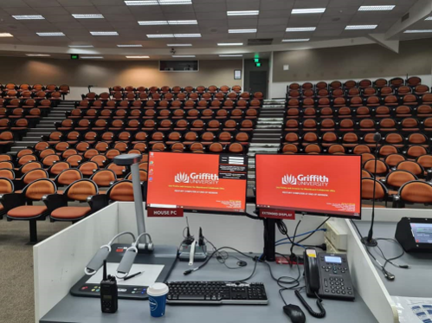
Griffith University
Australia
Whereas previous tracking designs relied on technologies such as wearable IR beacons to track a presenter, the Lumens VC-TR1 monitors the full width of the teaching area with a separate panoramic camera, keeping the subject always in view. During the initial installation, the user selects areas where tracking occurs and can also define exclusion zones to eliminate distractions from movement elsewhere in the space. Facial tracking technology then enables the main PTZ camera to smoothly track the presenter and provide appropriate framing at the whiteboard, lectern or wherever the academic may roam.
Success Stories
Higher-Education
Product: VC-TR1
With more than 55,000 students, Griffith University spans five campuses in South East Queensland, consistently ranking in the top two percent of universities globally. Propelled by the Covid-19 pandemic, online or hybrid learning is becoming an increasingly important part of the study options for students. For many courses, students are able to log in remotely to participate live in lectures and tutorial sessions or access recorded sessions using the online learning platform.
"Setting up the tracking and blocking zones, home position, and so on takes maybe another 10 minutes on top of what it would take to put in a normal PTZ and set three zones. Compared to the other products that we trialed, where we'd probably take half an hour or more to configure and fine tune, the Lumens product is quite good to work with.“
Andrew Williams
Griffith's Product Manager - Teaching Spaces

